Slide 1
Introduction to Cloud Computing

Slide 2
Service Models
Infrastructure as a Service
Platform as a Service
Software as a Service

Slide 3
Software as a Service
Software as a Service - SaaS
The capability provided to the consumer is to use the provider’s applications running on a cloud infrastructure. The applications are accessible from various client devices through a thin client interface such as a web browser (e.g., web-based email).
The consumer does not manage or control the underlying cloud infrastructure including network, servers, operating systems, storage, or even individual application capabilities, with the possible exception of limited user-specific application configuration settings.
Examples :
Google Apps (e.g., Gmail, Google Docs, Google sites, …etc)
SalesForce.com
EyeOS
… etc

Slide 4
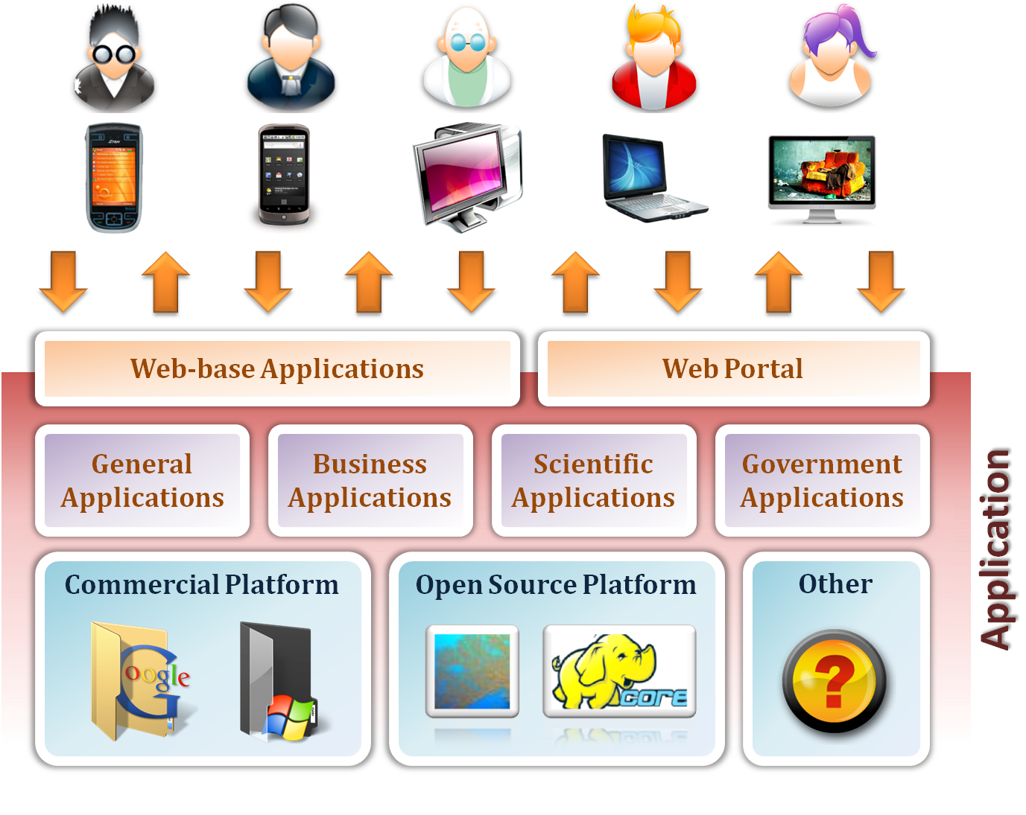
Software as a Service

Slide 5
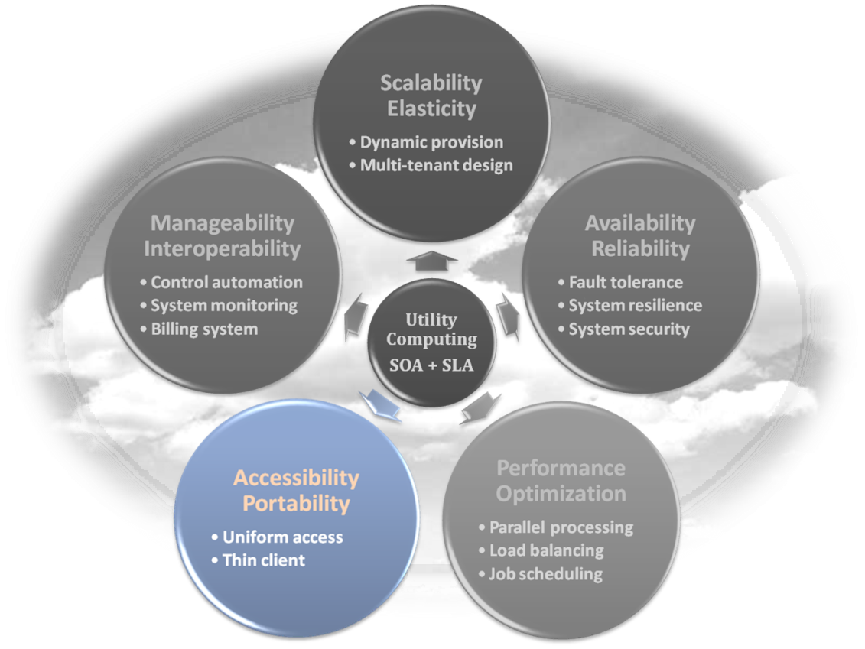
Software as a Service
Enabling Technique – Web Service
Web 2.0 is the trend of using the full potential of the web
Viewing the Internet as a computing platform
Running interactive applications through a web browser
Leveraging interconnectivity and mobility of devices
Enhanced effectiveness with greater human participation
Properties provided by Internet :
Accessibility and Portability

Slide 6
Software as a Service
Provide service – Web-based Applications
Conventional applications should translate their access interface onto web-based platform.
Applications in different domains
General Applications – Applications which are designed for general propose, such as office suit, multimedia and instant message, …etc.
Business Applications – Application which are designed for business propose, such as ERP, CRM and market trading system, …etc.
Scientific Applications – Application which are designed for scientific propose, such as aerospace simulation and biochemistry simulation, …etc.
Government Applications – Applications which are designed for government propose, such as national medical system and public transportation system service, …etc.

Slide 7
Software as a Service
Provide service – Web Portal
Apart from the standard search engine feature, web portals offer other services such as e-mail, news, stock prices, information, databases and entertainment.
Portals provide a way for enterprises to provide a consistent look and feel with access control and procedures for multiple applications and databases, which otherwise would have been different entities altogether.
Some examples :
iGoogle
MSNBC
Netvibes
Yahoo!

Slide 8
SaaS - Summary
SaaS is the finished applications that you rent and customize.
SaaS enabling technique
Web Service
SaaS provide services
Web-based Applications
General applications
Business applications
Scientific applications
Government applications
Web Portal

Slide 9
Deployment models
How to deploy a cloud system ?

Slide 10
Deployment Model
There are four primary cloud deployment models :
Public Cloud
Private Cloud
Community Cloud
Hybrid Cloud
Each can exhibit the previously discussed characteristics; their differences lie primarily in the scope and access of published cloud services, as they are made available to service consumers.

Slide 11
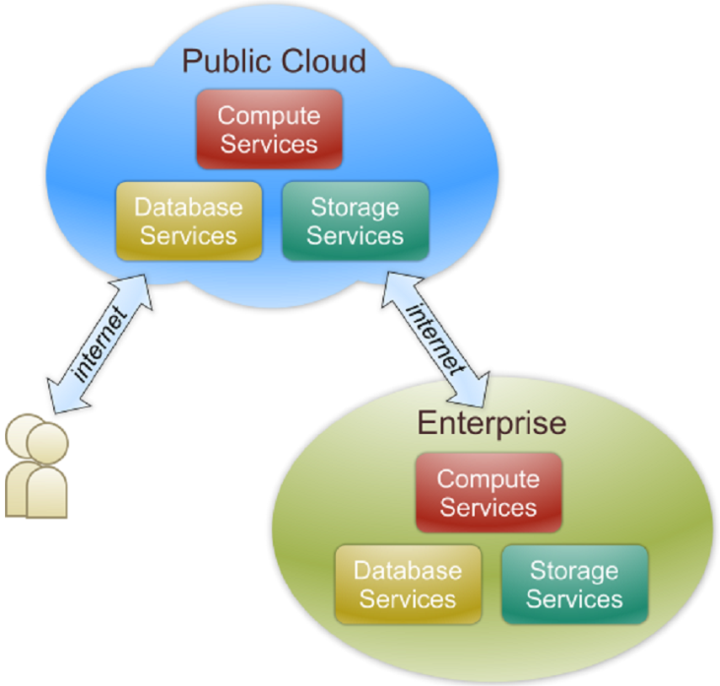
Public Cloud
Public cloud definition
The cloud infrastructure is made available to the general public or a large industry group and is owned by an organization selling cloud services.
Also known as external cloud or multi-tenant cloud, this model essentially represents a cloud environment that is openly accessible.
Basic characteristics :
Homogeneous infrastructure
Common policies
Shared resources and multi-tenant
Leased or rented infrastructure
Economies of scale

Slide 12
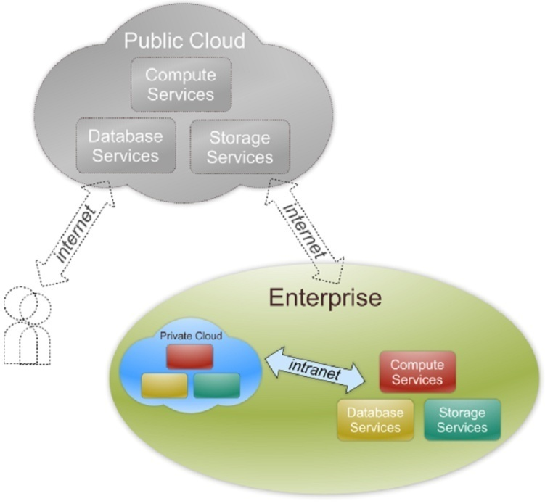
Private Cloud
Private cloud definition
The cloud infrastructure is operated solely for an organization. It may be managed by the organization or a third party and may exist on premise or off premise.
Also referred to as internal cloud or on-premise cloud, a private cloud intentionally limits access to its resources to service consumers that belong to the same organization that owns the cloud.
Basic characteristics :
Heterogeneous infrastructure
Customized and tailored policies
Dedicated resources
In-house infrastructure
End-to-end control

Slide 13
Public vs. Private
Comparison :
 | Public Cloud | Private Cloud
Infrastructure | Homogeneous | Heterogeneous
Policy Model | Common defined | Customized & Tailored
Resource Model | Shared & Multi-tenant | Dedicated
Cost Model | Operational expenditure | Capital expenditure
Economy Model | Large economy of scale | End-to-end control

Slide 14
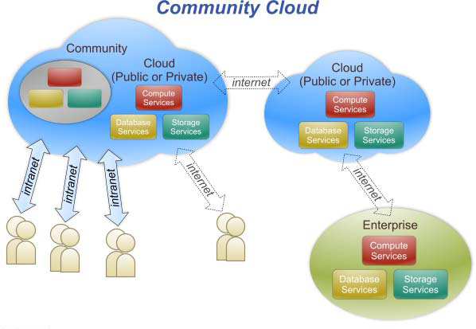
Community Cloud
Community cloud definition
The cloud infrastructure is shared by several organizations and supports a specific community that has shared concerns (e.g., mission, security requirements, policy, and compliance considerations).

Slide 15
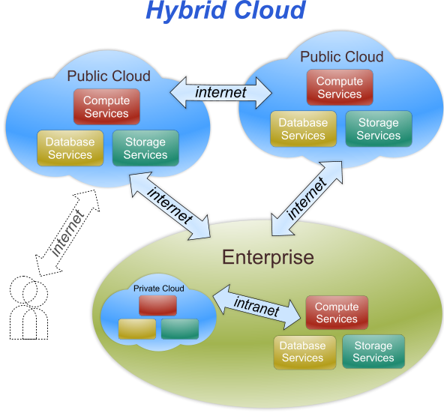
Hybrid Cloud
Hybrid cloud definition
The cloud infrastructure is a composition of two or more clouds (private, community, or public) that remain unique entities but are bound together by standardized or proprietary technology that enables data and application portability (e.g., cloud bursting for load-balancing between clouds).

Slide 16
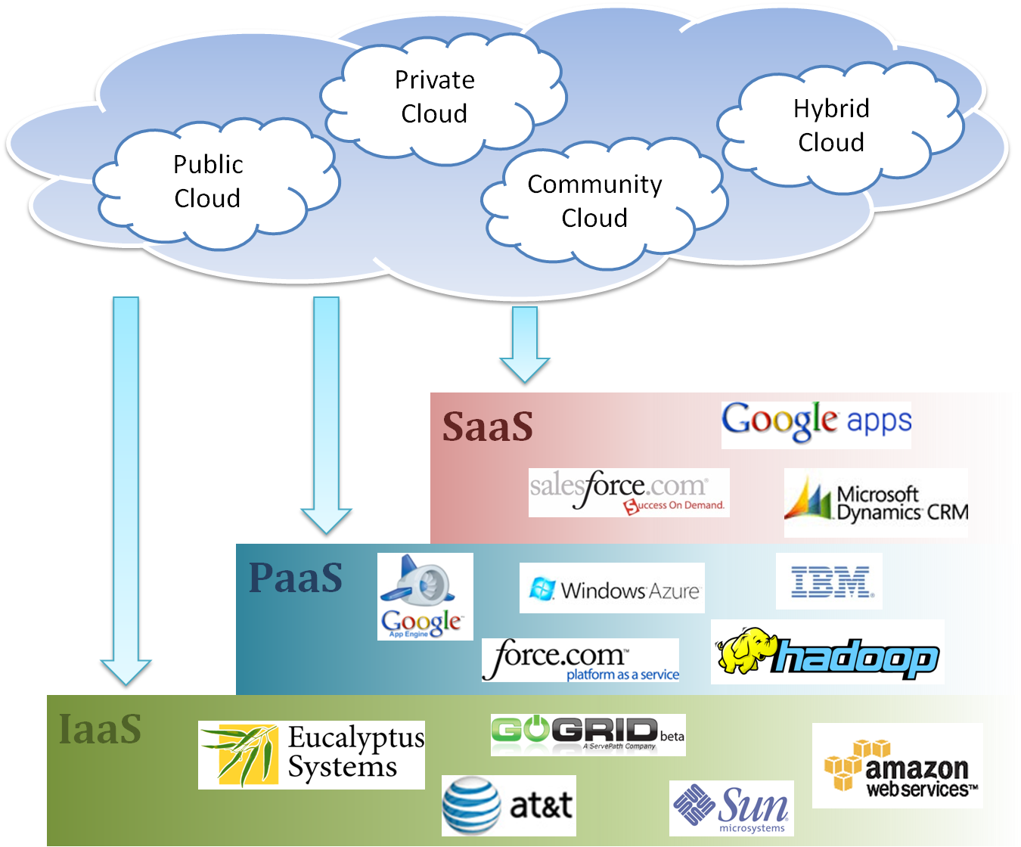
Cloud Ecosystem

Slide 17
Summary
What is cloud computing in your mind
Clear or Cloudy?
Cloud computing is a new paradigm shift of computing
Cloud computing can provide high quality of properties and characteristics based on essentially central ideas
Service models and deployment models provide services that can be used to
Rent fundamental computing resources
Deploy and develop customer-created applications on clouds
Access provider’s applications over network (wired or wireless)

